Slide 1
WooF!
Nafis Abeer, Justin Lam, Chase Maivald, Rajiv Ramroop, Daniel Shimon

Slide 2
table of contents
1
2
3
4
Deliverables
Competitors
Problem Statement
Engineering Requirements

Slide 3
1
Problem Statement
& Need for project

Slide 4
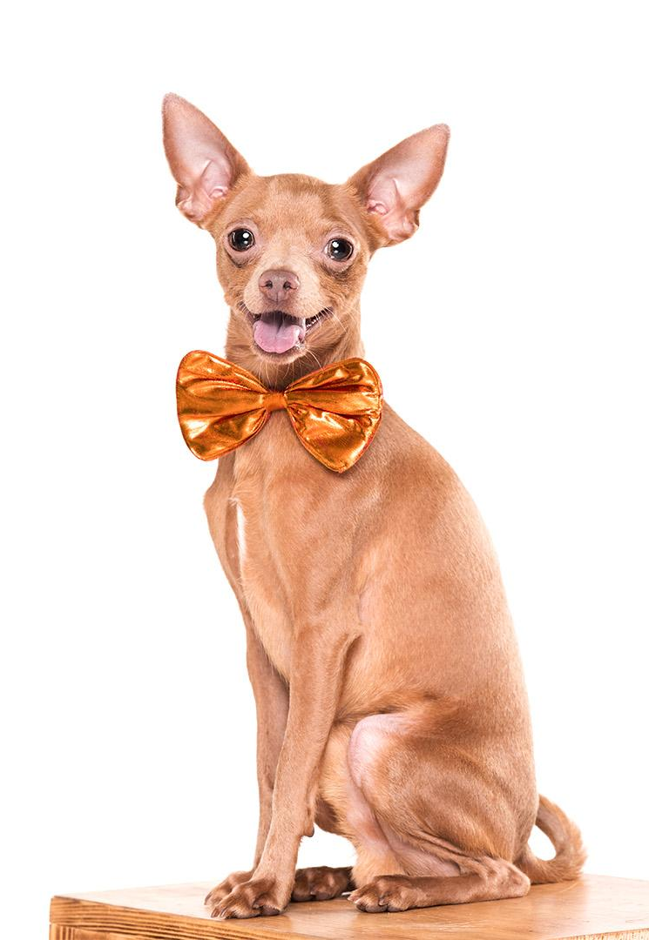
Need
Do you own a dog?
Want your furry friend to choose their friends?
Want to visit the park at the same time as those friends?
Want to never lose your pet?

Slide 5
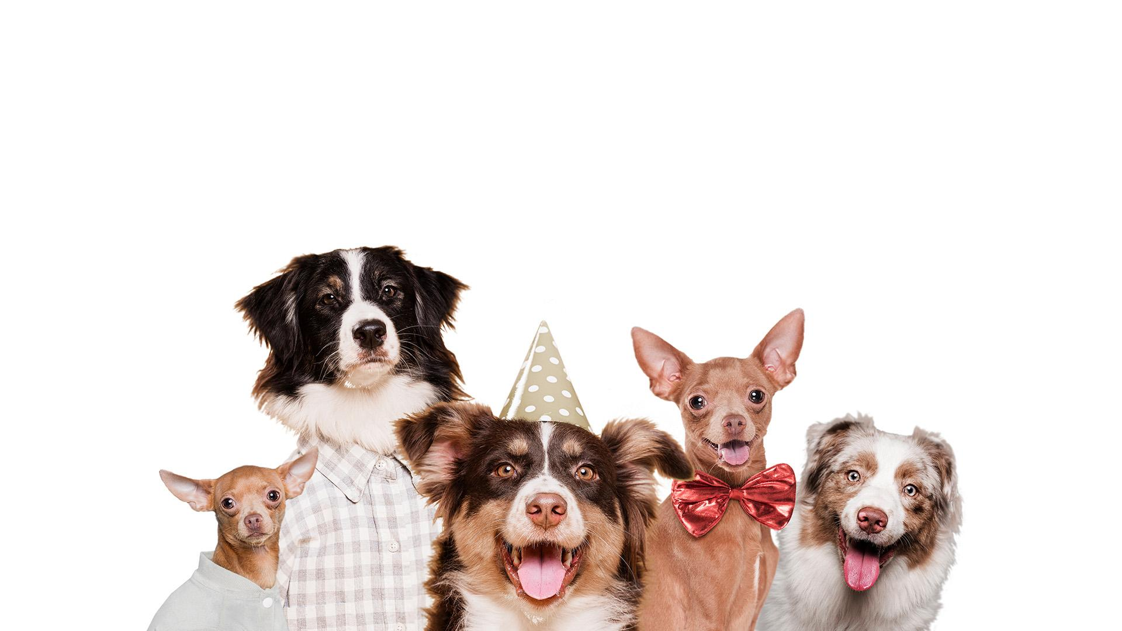
We Offer you an App that lets your dog choose their Own friends

Slide 6
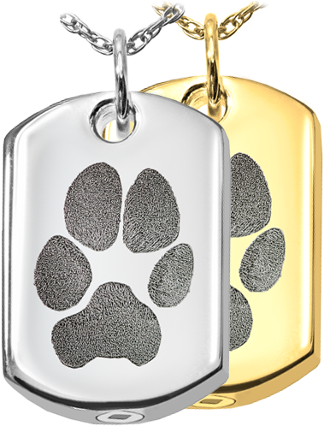
An App with an Accessory

Slide 7
2
Deliverables
& Visualization

Slide 8
What to expect
Dog Maps
Add Friends
Suggestions
Tracker
Check your dog map to arrange dog park visits
Show your dog off or Message and coordinate walks
Recommendations to add friends when your dog gets along with other dogs
Never lose your furry friend with a real-time GPS fitted collar

Slide 9
Bonus Feature
Accelerometer fitted into collar to lets you know what your pup is up to while you’re away from home

Slide 10
Front End
Friends
Profile
Map
Suggestions
Business page
Find friends for your dog to interact and play with
Build a social media presence for other dogs to interact with
Find your friends on the map + Track your dog
Ads from local businesses
Get suggested friends to add based on the interaction your dog has with others

Slide 11
Recommender System
GPS tracker
Tags
Accelerometer
Retrieves dogs real-time location in relation to other collars
Mounts sensors with microcontroller
Retrieves information about dogs movements

Slide 12
Dog maps API
Snapmaps like features shows your friends based on their privacy settings

Slide 13
Database
Profile
Maps
Profile picture
Pet/owner name
Age, weight
Breed
Your friends dynamic location
Visited Parks?

Slide 14
3
Competitors

Slide 15
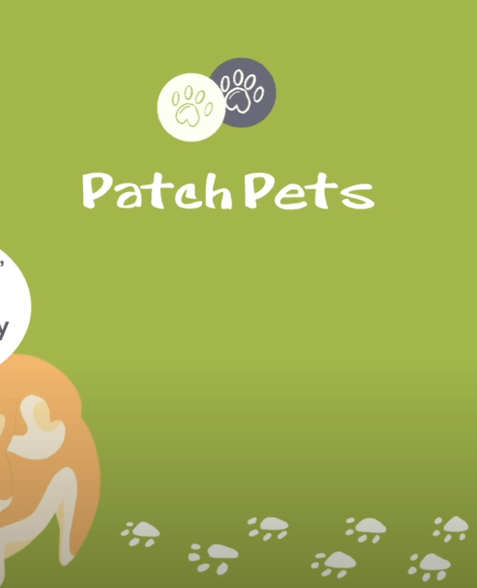
Patch Pets
• Discover Page: Discover nearby dogs via their location
• Business Directory: Discover local dog-friendly businesses within their directory
• Dog Profile: Create a social profile for your pup, from which you can connect with other friends
• Dog Park Maps: Find nearby dog parks and see which of your doggo pals are there in real-time
• Chat Feature: Connect and chat with friends.
• Dog Park Noticeboards: Access local dog park noticeboards, where your doggo pals can provide any updates or information concerning the dog park.

Slide 16

Petzbe
• Creatively share your unique pet lifestyle!
• Pawwticipate in our monthly #LendAPaw campaign where we raise money for pets in need! With the help of our community, Petzbe has donated over $120k to helping fellow pets.
• Sniff around and make best furrrends with fellow pets!
• Access tons of adorable stickers & frames TAILor made for YOU. Have a blast decorating all of your original content!
• Plan & host virtual celebrations & events with your favorite PetzbePals because everyone loves a great pawwty!
• Join weekly creative challenges & contests so you can interact & learn more about all of your *Sniffers!* It is playtime all the time!
• Use our Discussion Boards to post your thoughts, stories, recommendations, questions & comments so you can chat & connect with other users!

Slide 18
4
Engineering
Requirements

Slide 19
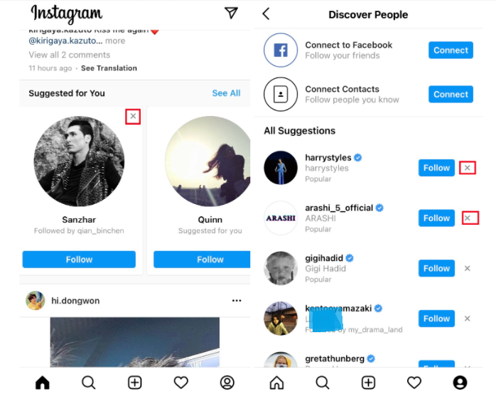
1st Engineering Requirement
Recommendations
Same way instagram suggests followers
Recommender system designed based on proximity of dog tags
If your dog runs around for 10 minutes with another dog, their profile is suggested
Hostile interactions wouldn’t last long because owners would separate dog
Constraint: training set

Slide 20
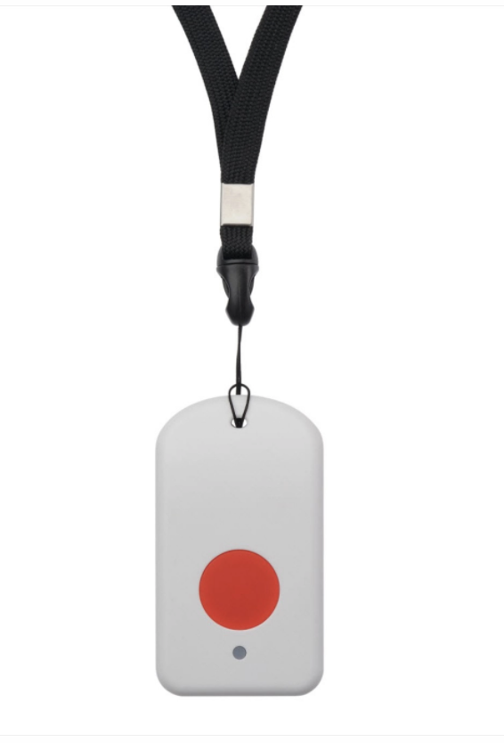
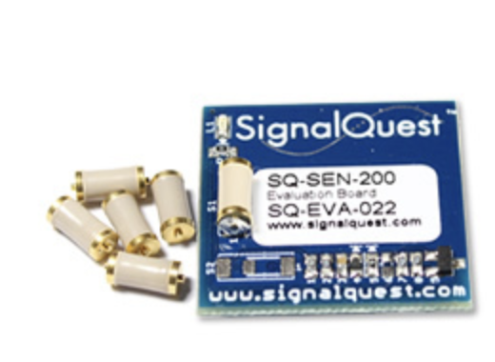
2nd Engineering Requirement
Tracker
Use of accelerometer to detect movement
One possible approach- LoRaWAN sensor
Provides GPS information
Detects change in motion to be used for ML data
Constraints- Fit
Notes:
First eng requirement - tracker (Never lose your furry friend with a real-time GPS fitted collar

Slide 21
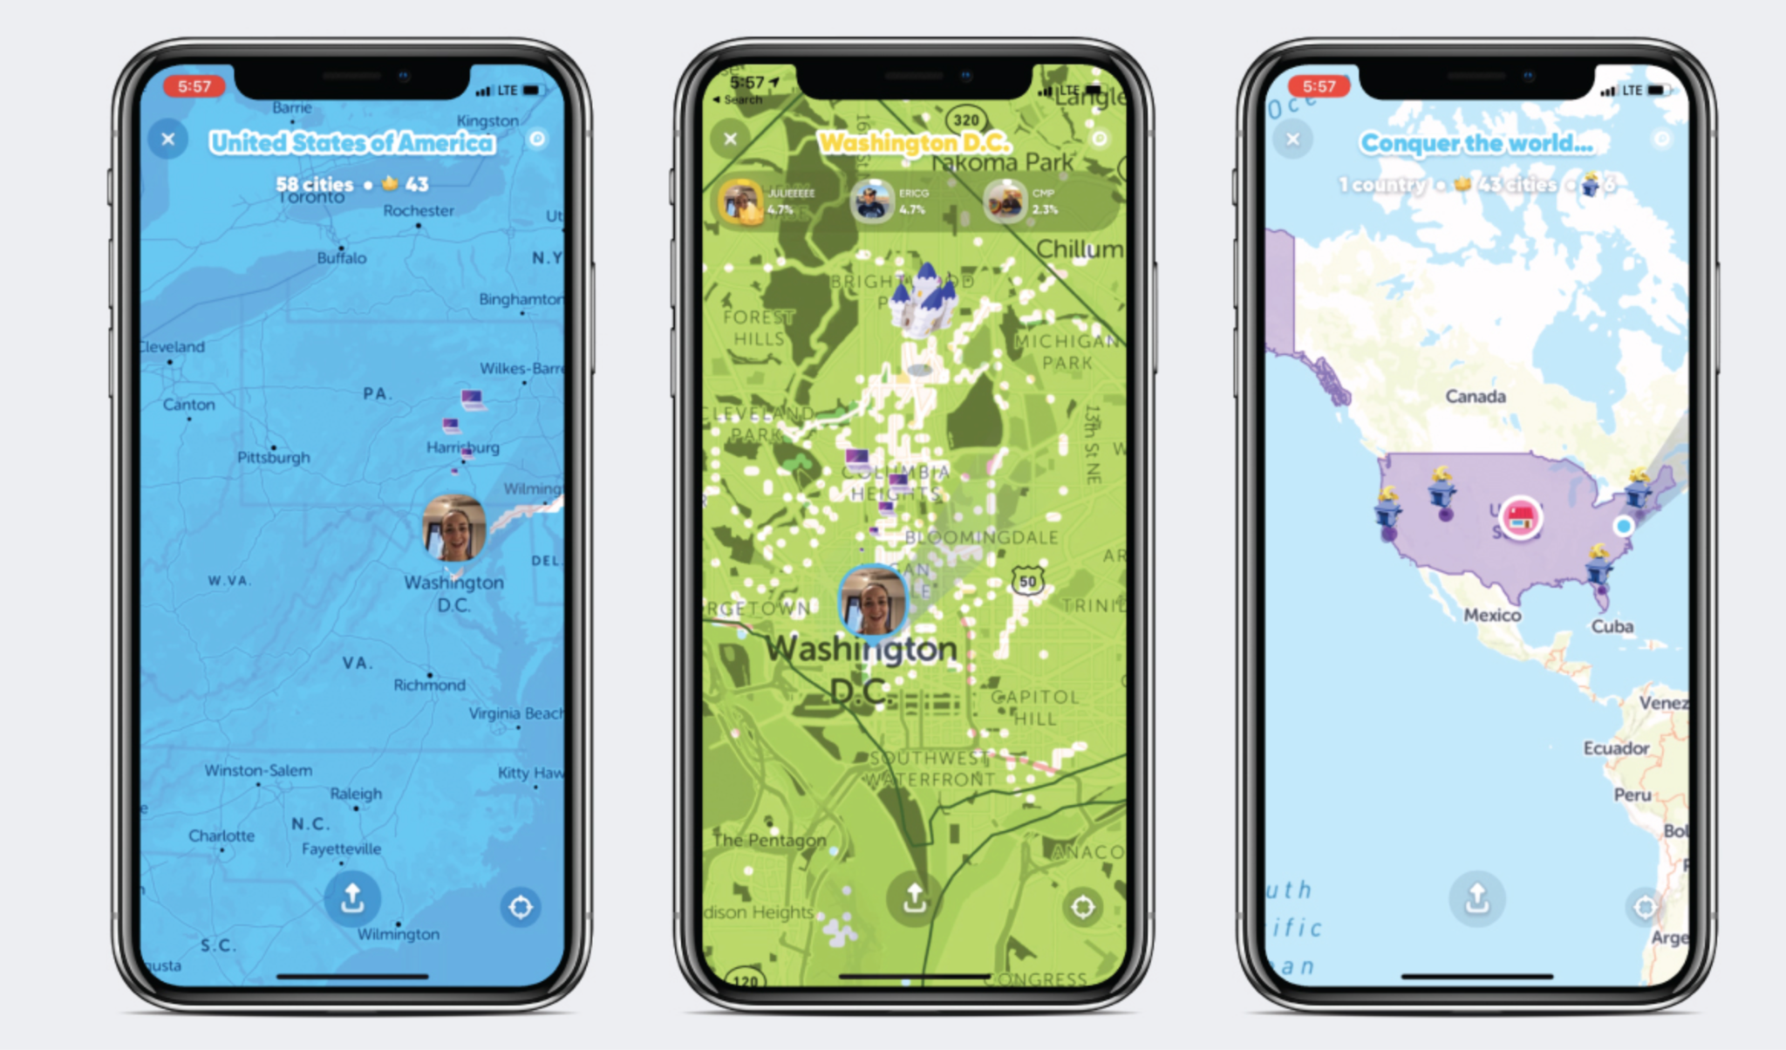
3rd Engineering Requirement
Dog maps API
Think Snap Maps, but for your dog
One possible approach: Mapbox (Zenly)
Issues: need to choose iOS or Android
Snap Maps, Accuweather, AllTrails, all use Mapbox
Constraint: only iOS

Slide 22
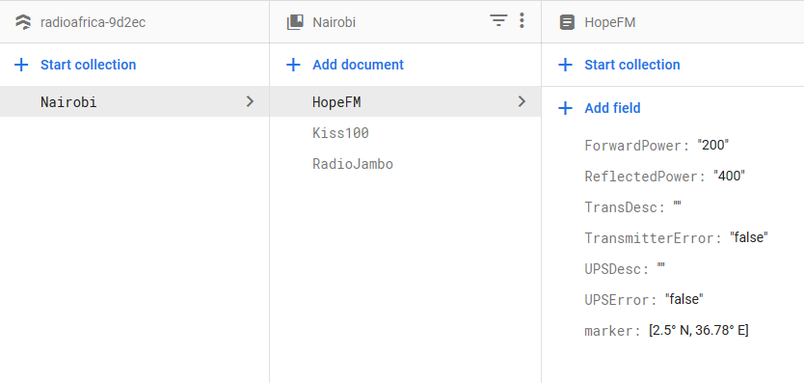
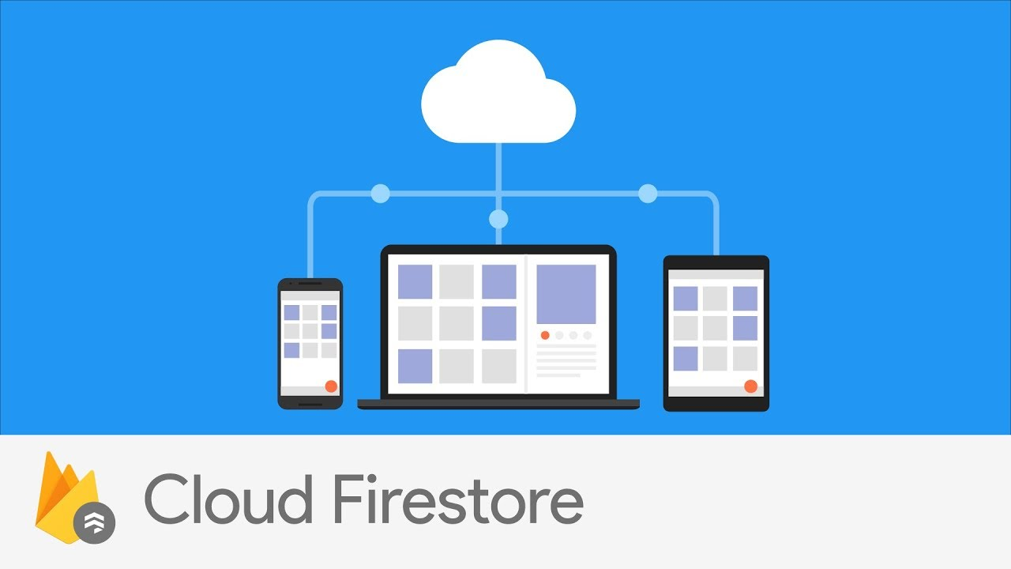
4th Engineering Requirement
Working DataBase
Real-time back end via Firestore allows user profiles and trip history to display/update
Separate collection for profile/story

Slide 23

thanks
Any Questions?

